Slide 1
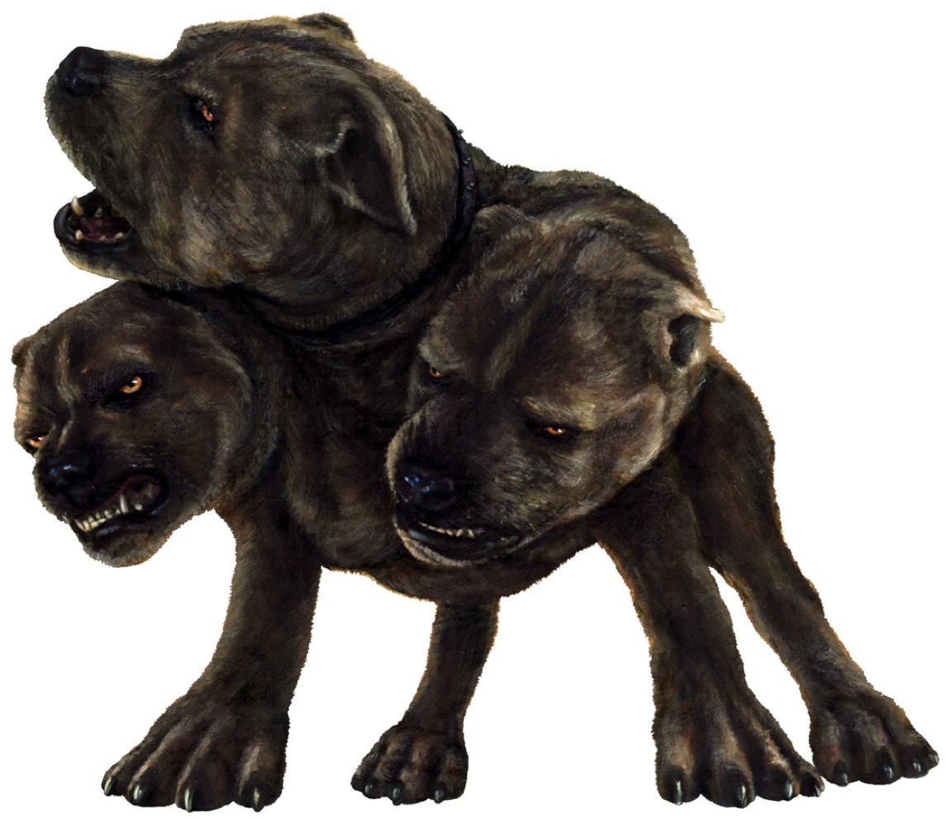
Kerberos

Slide 2
Course Layout – Hacking 300
Lesson 1 – Introduction to Enterprise Networks Lesson 2 – Windows Domains and Active Directory Lesson 3 - Linux Networks
Lesson 4 – Kerberos Fundamentals
Lesson 5 – Attacking Domain Environments
Lesson 6 – CTF Start Lesson 7 – CTF Q&A
Lesson 8 – CTF Q&A Lesson 9 – CTF Q&A
Lesson 10 - Outbrief and Course Conclusion
← Today
Real-world systems: ethical hacking practicum – UW Summer 2021

Slide 3
AD/LDAP vs Kerberos
Segregation of duties
Authz/Authn is an expensive task
Directory, Resources, and User management is an expensive tasks
Down to the protocol level they serve different purposes
AD = Keep track of/manage resources and users on a network
Kerberos = Specifically the access control step, proving authz/authn
Keep in mind understanding these will tell us what is happening when you run classic tools like Mimi Katz or use “golden ticket” attacks.
Notes:
Why talk about kerberos and why is there yet another thing???
Kerberos is an authentication protocol.
It is designed for client-server applications and requires mutual verification.
Active Directory (AD) is a component running on the DC that implements the Kerberos account database (containing users and passwords).
AD = manage users on a network, and Kerberos = authentication component leveraged by AD
Kerberos vs LDAP/AD, we want to separate duties and resources
Kerberos is the inside-the-corporate-network industry standard single sign-on protocol.
LDAP was always more of a directory look-up protocol. However, LDAP can also do authentication that was added later.
In LDAP auth, and every authentication attempt is going to cause a load on the Directory authentication server, so in that sense, it could hammer your Directory authentication server often.
In Kerberos auth, after the first authentication, the client holds a ticket that will be good for a default of 10 hours so that additional authentication attempts do not have to overload your Directory authentication server again.
In short, as an authentication protocol Kerberos is far more secure out of the box, is de-centralized, and will put less load on your Directory authentication servers than LDAP will.
Kerberos in pure Microsoft Active Directory environments will do both authentication and authorization for you, while directory look-ups is always LDAP.
Also, LDAP is not single sign-on. Users must always manually enter username/password while with Kerberos they do not have to do this.

Slide 4
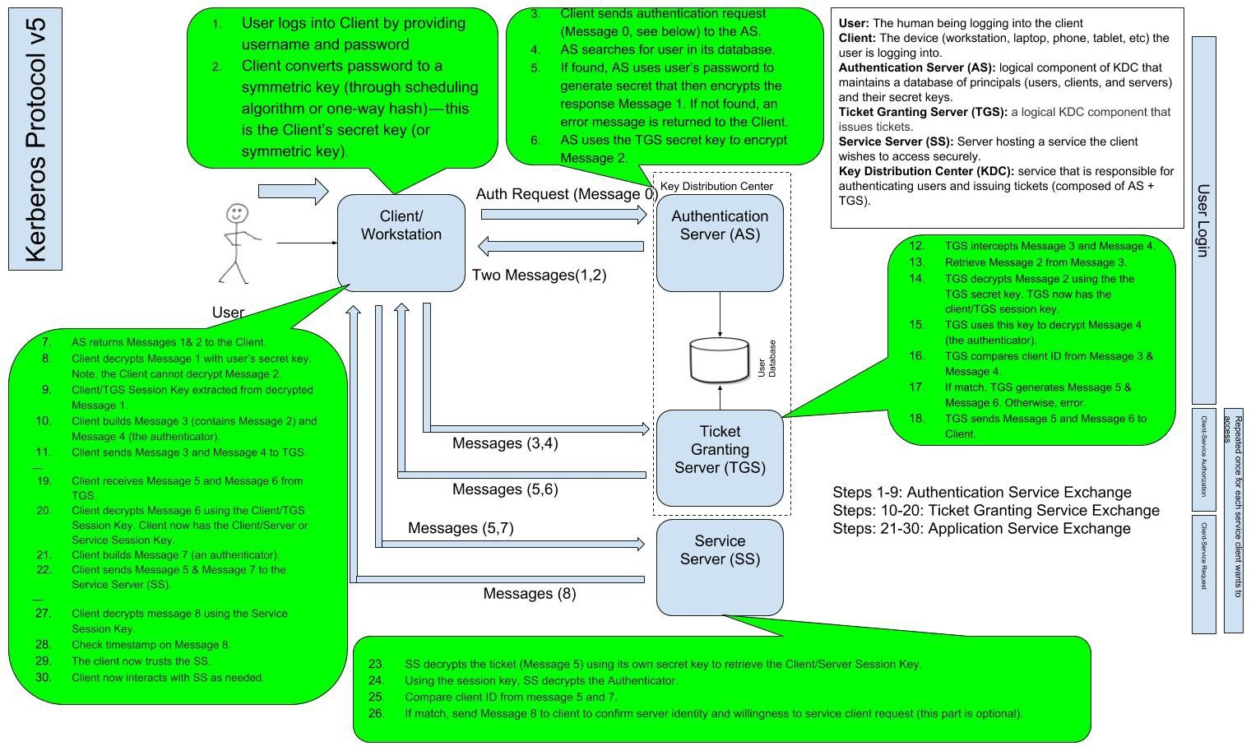
https://medium.com/@robert.broeckelmann/kerberos-and-windows-security-kerberos-v5-protocol-b9c804e06479 https://medium.com/@robert.broeckelmann/kerberos-and-windows-security-kerberos-on-windows-3bc021bc9630

Slide 5
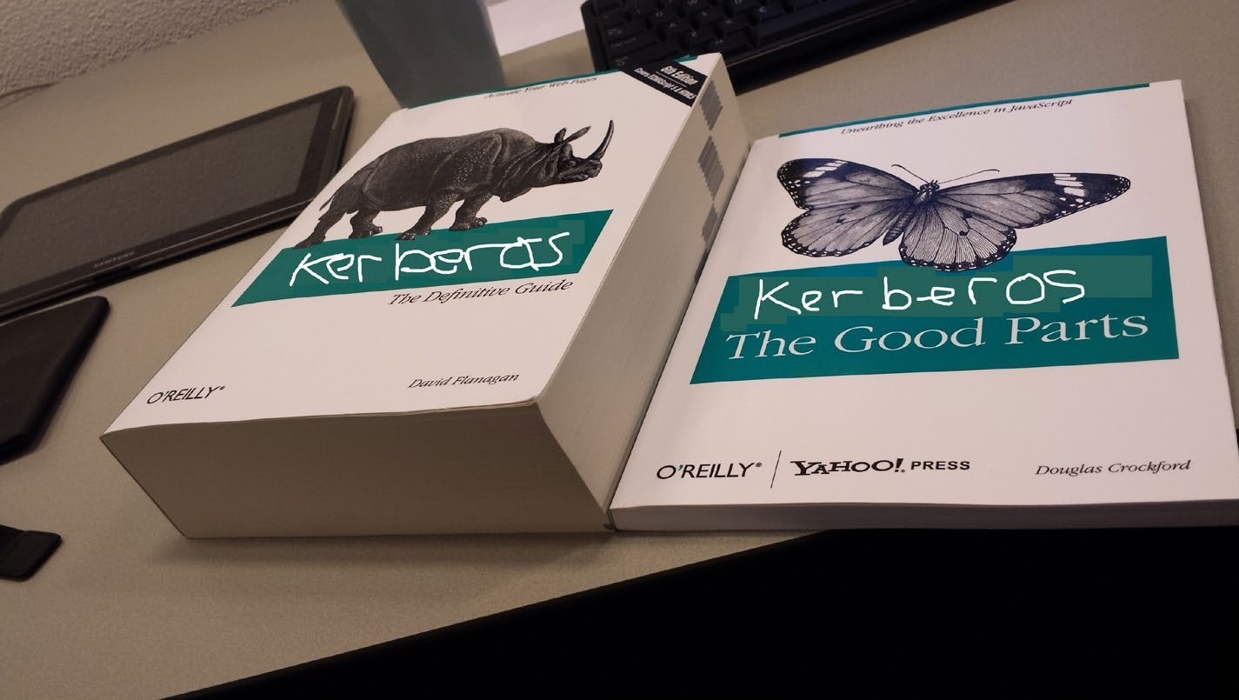
Kerberos
Objectives
Give you “the good parts” of Kerberos
The full extent of the protocol + related RFCs way too much to cover in one lecture
Aim for a solid understanding of fundamentals
Give you a revisit our understanding of
Cryptography, necessary for next concepts
Microsoft domain specifics related to Kerberos
Vulnerabilities and attacks related to Kerberos
Tools related to Kerberos

Slide 6
Crypto made easy

Slide 7
Some key ideas in crypto
The main idea in cryptography is to assume that all communications between Alice and Bob are viewable by a third party, Eve.
How can we still communicate in a secure way?
Symmetric Cryptography
One key is used to perform encryption as well as decryption
Asymmetric Cryptography
Mathematically related key pair: public and private
Encrypt with public key, decrypt with private key
Key exchange
Agree on a key (usually to use for follow-up symmetric operations)

Slide 8
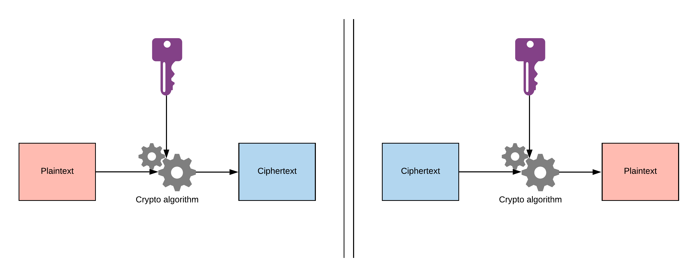
Symmetric cryptography

Slide 9
Symmetric cryptography
A silly, contrived, probably irresponsible, but hopefully illustrative example
Plaintext = “Attack at dawn“
Key = 0x1337
Encryption algorithm = XOR (Don’t do this for real, this is just a fast example)
Operations
1 XOR 1 = 0
1 XOR 0 = 1
0 XOR 0 = 0
0 XOR 1 = 1
Property
A XOR B = C means C XOR B = A.
So, $Plaintext XOR $Key = $Ciphertext; $Ciphertext XOR $Key = $Plaintext.

Slide 10
Silly symmetric key crypto example
Plaintext
A | t | t | a | c | k |  | a | t |  | d | a | w | n
0x0041 | 0x0074 | 0x0074 | 0x0061 | 0x0063 | 0x006b | 0x0020 | 0x0061 | 0x0074 | 0x0020 | 0x0064 | 0x0061 | 0x0077 | 0x006e
0x0041 | 0000 | 0000 | 0100 | 0001
 |  | XOR
0x1337 | 0001 | 0011 | 0011 | 0111
XOR
Key
0x1337 | 0x1337 | 0x1337 | 0x1337 | 0x1337 | 0x1337 | 0x1337 | 0x1337 | 0x1337 | 0x1337 | 0x1337 | 0x1337 | 0x1337 | 0x1337
=
=
Ciphertext
0x1376 | 0x1343 | 0x1343 | 0x1356 | 0x1354 | 0x135c | 0x1317 | 0x1356 | 0x1343 | 0x1317 | 0x1353 | 0x1356 | 0x1340 | 0x1359
፶ | ፃ | ፃ | ፖ | ፔ | ፜ | ፜ | ፖ | ፃ | ፜ | ፓ | ፖ | ፀ | ፙ
0x1376
0001 0011 0111 0110

Slide 11
Symmetric enc. uses the same key to decrypt too:
Ciphertext
0x1376 | 0x1343 | 0x1343 | 0x1356 | 0x1354 | 0x135c | 0x1317 | 0x1356 | 0x1343 | 0x1317 | 0x1353 | 0x1356 | 0x1340 | 0x1359
፶ | ፃ | ፃ | ፖ | ፔ | ፜ | ፜ | ፖ | ፃ | ፜ | ፓ | ፖ | ፀ | ፙ
XOR
Key
0x1337 | 0x1337 | 0x1337 | 0x1337 | 0x1337 | 0x1337 | 0x1337 | 0x1337 | 0x1337 | 0x1337 | 0x1337 | 0x1337 | 0x1337 | 0x1337
=
Plaintext
A | t | t | a | c | k |  | a | t |  | d | a | w | n
0x0041 | 0x0074 | 0x0074 | 0x0061 | 0x0063 | 0x006b | 0x0020 | 0x0061 | 0x0074 | 0x0020 | 0x0064 | 0x0061 | 0x0077 | 0x006e

Slide 12
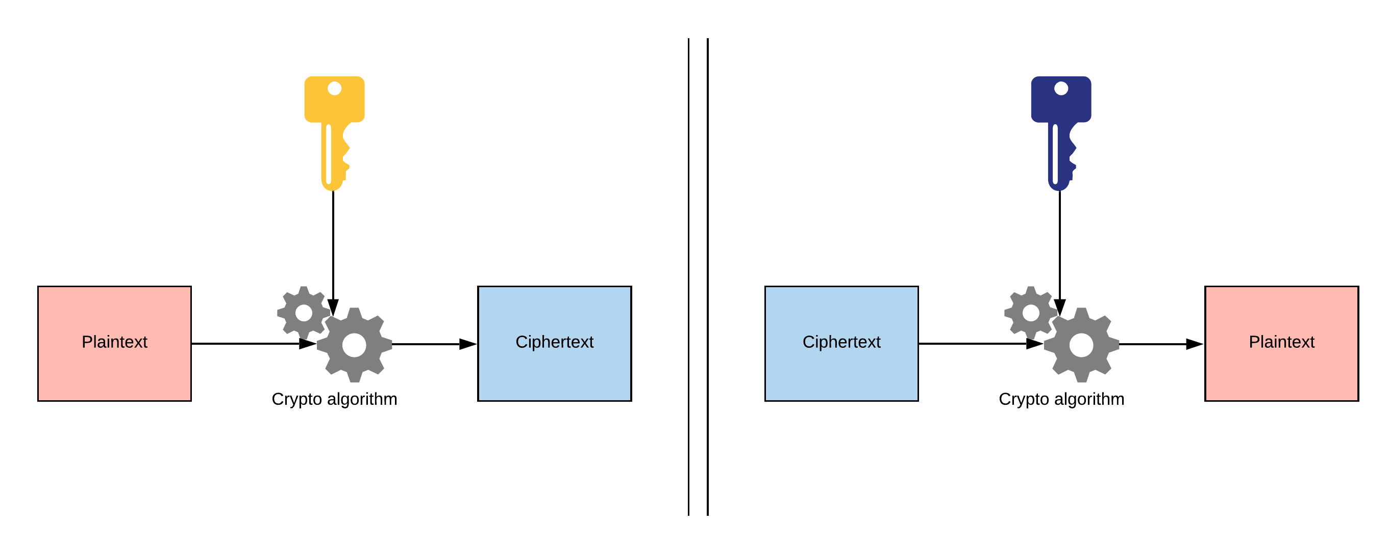
Asymmetric cryptography
For example, in RSA:
Plaintext = Dec(Ciphertext)
= Ciphertext^{𝐷} mod 𝑁
=( Plaintex𝑡^{𝐸} mod 𝑁 )^{𝐷} mod 𝑁
= Plaintex𝑡^{𝐸𝐷} mod 𝑁
= Plaintex𝑡
Ciphertext = 𝐸𝑛𝑐(Plaintext) = Plaintext^{𝐸} mod 𝑁.

Slide 13
Using these abstract crypto concepts in real systems

Slide 14
Scenario 1: How can Alice send a message to Bob that only Bob can read?
In public key cryptography systems,
All identities publish their public key to a directory
User | Public key
Alice | 0x1234
Bob | 0x5678
All identities keep their private key to themselves
Answer: Alice takes Bob’s public key from the directory, encrypts her message with Bob’s key, and then sends it to him.

Slide 15
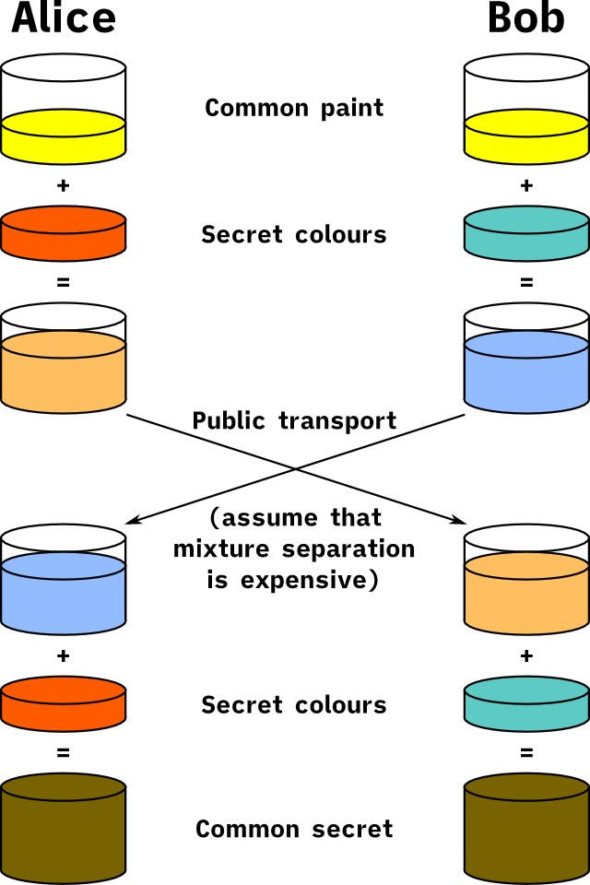
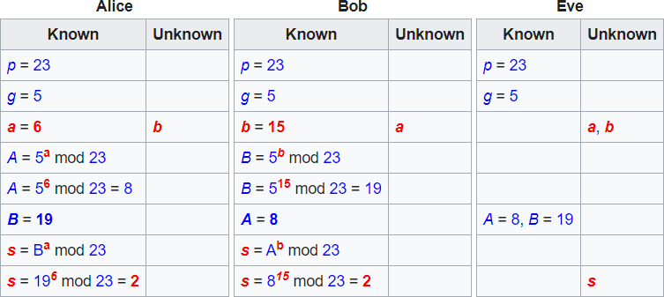
Scenario 2: How can Alice and Bob agree on a shared secret without leaking it?
- Use a technique such as Diffie-Hellman key exchange
- DH isn’t widely used in Kerberos deployments, but it’s still good to know!
Notes:
Diffie-Hellman key exchange was one of the most important developments in public-key cryptography and it is still frequently implemented in a range of today’s different security protocols.
allows two parties who have not previously met to securely establish a key which they can use to secure their communications.
first widely used method of safely developing and exchanging keys over an insecure channel
Even if we want to “password protect” something, or more realistically use a symmetric key to encrypt something, we have the problem of how do we securely get that password/key to the person who should have it so they can read the message after?
Diffie-Hellman key exchange was the first publicly-used mechanism for solving this problem. Wasn’t until 1976 that public-key algorithms really started being used in general public application. This was when Whitfield Diffie and Martin Hellman published a paper that became the Diffie-Hellman key exchange.
(image on left) - analogy for the Diffie-Hellman scheme is to think of two people mixing paint.
Let’s use the cryptography standard, and say that their names are Alice and Bob.
They both agree on a random color to start with.
Let’s say that they send each other a message and decide on yellow as their common color, just like in the diagram
They set their own color. They do not tell the other party their choice.
Let’s say that Alice chooses red, while Bob chooses a slightly-greenish blue.
next step is for both Alice and Bob to mix their secret color (red for Alice, greenish-blue for Bob) with the yellow that they mutually agreed upon.
according to the diagram, Alice ends up with an orangish mix, while Bob’s result is a deeper blue.
Once they have finished the mixing, they send the result to the other party.
Alice receives the deeper blue, while Bob is sent the orange-colored paint.
Once they have received the mixed result from their partner, they then add their secret color to it.
Alice takes the deeper blue and adds her secret red paint, while Bob adds his secret greenish-blue to the orange mix he just received.
The result? They both come out with the same color, which in this case is brown, This shared color is referred to as the common secret.
The critical part of the Diffie-Hellman key exchange is that both parties end up with the same result, without ever needing to send the entirety of the common secret across the communication channel.
All an attacker could get is the starting yellow color and the mixed colors they send to each other, but think a crazy amount of options
Now how do we related this to say how the symmetric keys is decided upon in SSL handshakes?
Diffie-Hellman is a key agreement protocol, meaning that if two parties (say, the SSL client and the SSL server) run this protocol, they end up with a shared secret K.
protocol whereby two or more parties can agree on a key in such a way that both influence the outcome. If properly done, this precludes undesired third parties from forcing a key choice on the agreeing parties. Protocols that are useful in practice also do not reveal to any eavesdropping party what key has been agreed upon.
However, neither client or server gets to choose the value of K; from their points of view, K looks randomly generated.
It is secret (only them know K; eavesdroppers on the line do not) and shared (they both get the same value K), but not chosen.
This is not the act of encryption, it’s a protocol for the key exchange part of public key crypto and the specific algorithms and math involved.
If the shared secret K is “good enough”, though, to process terabytes of data with a symmetric encryption algorithm (same K to encrypt on one side and decrypt on the other), and that is what happens in SSL.
Diffie-Hellman is used in SSL/TLS (the cipher suites with "DHE" in their name), but typically rarely used now
Why talk about this? To highlight the history of things and that its all about asymmetric and symmetric encryption, and being able to securely get core secrets to each other regardless of what methods we end up using.

Slide 16



Scenario 3: Suppose Alice and Bob have a shared symmetric key
How can Alice prove to Bob that she has the key without sending the key itself?
Encrypted with session key
Encrypted with session key
{Timestamp}
{Timestamp}

Slide 17
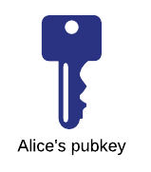

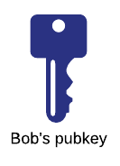


Scenario 4: Suppose Alice and Bob are members of the same Kerberos realm (Windows domain).
How can the KDC send private, confidential messages to Alice and Bob?
Encrypted with Alice’s public key
User
Public key
{Message}
Alice
Bob
Encrypted with Alice’s public key
Encrypted with Alice’s public key
{Message}
{Message}

Slide 18
Back to Kerberos

Slide 19
What is Kerberos
An authentication protocol developed at MIT during the 80s
V4 was first “public” version, had a number of security problems
V5 initially published in early 90s under RFC 1510
https://tools.ietf.org/html/rfc1510
V5 updated in 2005 with RFC 4120 to address more security problems (latest version)
https://tools.ietf.org/html/rfc4120
A number of related RFCs exist to specify cryptography and other extensions to Kerberos
Notes:
Kerberos uses symmetric key cryptography and requires trusted third-party authorization to verify user identities.
Since Kerberos requires 3 entities to authenticate and has an excellent track record of making computing safer, the name really does fit.
Microsoft introduced their version of Kerberos in Windows2000.
Before Kerberos, Microsoft used an authentication technology called NTLM.
NTLM stands for NT Lan Manager and is a challenge-response authentication protocol.
The target computer or domain controller challenge and check the password, and store password hashes for continued use.
The biggest difference between the two systems is the third-party verification and stronger encryption capability in Kerberos.
This extra step in the process provides a significant additional layer of security over NTLM.

Slide 20
Different implementations of Kerberos
MIT Kerberos (the “original”)
Open source
Microsoft implementation
Default authentication provider for Windows
Heimdal
Open implementation written in Sweden
MIT already open sourced Kerberos, why would someone write it in Sweden?

Slide 21
What problem does Kerberos solve?
Authenticate different principals (identities) on a network without:
Trusting the network
Assume traffic can be read/modified by MITM
Assume we can't trust IP addresses (spoofing possible)
Physical security of workstations
Assume anyone can walk up to another user's workstation and use it
Requiring the OS to do its own authentication of users
Kerberos acts as a “trusted third party” in the network
Single Sign-On (SSO)
Prompt users only when they first start their session (log on to a machine), not every time they access a protected resource
Notes:
A client requests a ticket for a user from the KDC using the user’s password to encrypt the request.
If the KDC can decrypt the request with the user’s password it knows, it knows the client has supplied the correct password for the user.
The KDC creates a ticket-granting ticket (TGT) for the user and encrypts the TGT with the user’s password and returns it to the client.
If the client can decrypt the ticket with the password it has then it knows that the KDC is legitimate (this is a form of mutual authentication).
We will go into more depth in a bit

Slide 22
What Kerberos (by itself) does NOT do:
Authorization
Although the spec leaves room in different message structures so that you can extend them to provide authorization
Example: the “PAC” (Privilege Attribute Certificate) is sent in Active Directory to provide authorization
Protect against DoS, password brute force
Protect against compromised DNS or directory servers
Protect environments that misuse Kerberos

Slide 23
Kerberos realms
Kerberos infrastructure is organized by “realm”
Most of the time equivalent to “domain”
Parent/child realms
Same naming convention - compsci.washington.edu
Realms can be configured to allow users to authenticate “cross realm”
Domain trusts we talked about last time
A key exchange between realms allows KDCs (Key Distribution Center; like a domain controller) in one realm to pass requests on to another realm

Slide 24
Kerberos principals
Uniquely identify users, services, or computers
User
bob@compsci.Washington.edu
Aka User Principal Name (UPN)
Sometimes written like: COMPSCI\Bob
Service
cifs/FILESERV99@compsci.washington.edu
Aka Service Principal Name (SPN)
Computer
host/bobworkstation.compsci.washington.edu@compsci.washington.edu
Each principal has a long-term secret key that forms the basis of cryptographic operations in Kerberos

Slide 25
Key Distribution Center (KDC)
The main administrative role in Kerberos
Sometimes discussed as 2 separate entities
Authentication Server (AS) / Ticket-Granting Server (TGS)
In reality, they are two different components that operate together in the KDC
Any of the 3 names here may be used to refer to the KDC
Just be aware of this when reading docs
KDC/AS/TGS all refer to the same thing
Also domain controller (DC)
KDC has its own long-term secret key used to encrypt/sign parts of certain tickets
The principal holding this key is called “krbtgt”
Notes:
Client: The entity seeking to provide its identity.
Application Server (AP): The service that the client (or user) wants to access.
Key Distribution Center (KDC): The trusted third-party, which issues tickets. In Active Directory each domain controller acts as a KDC. The KDC provides two core services: Authentication Service (AS) which authenticates clients and issues them tickets and the Ticket-Granting Service (TGS) which accepts authenticated clients and issues them tickets to access other resources.

Slide 26
Key Distribution Center (KDC)
Contains the entire list of principals and their secret keys
Uses cryptography to issue tickets to principals that authenticate them to other principals (users/services/computers)
Trusted third party – Is this really who I am talking to?
Most authentication flows in Kerberos involve the KDC or data from the KDC in some way

Slide 27
Scenario: Bob wants to access fileserv.

Slide 28
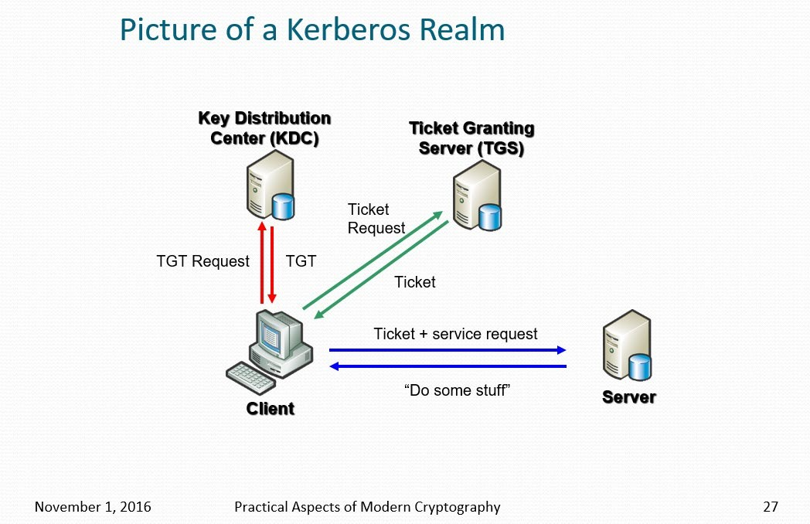
1
2
3
https://courses.cs.washington.edu/courses/csep590e/16au/slides/lecture5.pptx, slide 27:
Notes:
A client requests a ticket for a user from the KDC using the user’s password to encrypt the request.
If the KDC can decrypt the request with the user’s password it knows, it knows the client has supplied the correct password for the user.
The KDC creates a ticket-granting ticket (TGT) for the user and encrypts the TGT with the user’s password and returns it to the client.
If the client can decrypt the ticket with the password it has then it knows that the KDC is legitimate (this is a form of mutual authentication).
A client requests a ticket for a service from the KDC by presenting it’s TGT and a ticket-granting service (TGS) request that includes the service principal name for the service it would like to access.
The KDC creates a service ticket (TGS) which is encrypted with the service’s password hash, then encrypts the ticket and authenticator message with the shared ticket-granting service session key, and finally sends the TGS back to the client.
A client requests access to an application server (service) by presenting the service ticket it obtained from the KDC to the application server, which decrypts the message using its own password hash.
If it successfully decrypts the TGS, the application server grants access to the client.

Slide 29

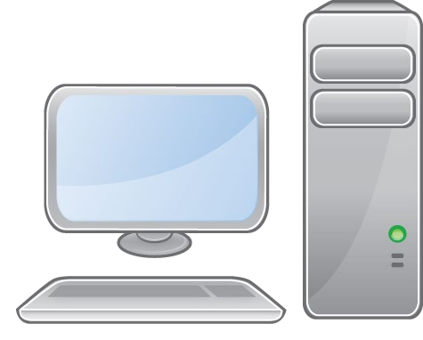
1) Authentication Server (AS)
Exchange
KRB_AS_REQ
Principal: bob@corpdomain.example.com Realm: corpdomain.example.com
Server: bobwstation@corpdomain.example.com
KDC
(corpdom ain.exam ple.com)
Bob's Workstation (bobwstation.cor pdomain.exampl e.com)
KRB_AS_REP
Principal: bob@corpdomain.example.com Ticket (TGT) plaintext:
Realm: corpdomain.example.com
Server: bobwstation@corpdomain.example.com Ticket (TGT) Encrypted Part
Encrypted with Bob’s public key
TGS session key

Slide 30
2) Ticket-Granting Service (TGS) Exchange
KRB_TGS_REQ
Principal: bob@corpdomain.example.com Realm: corpdomain.example.com
SPN: cifs / fileserv@corpdomain.example.com
Authenticator:
Encrypted with TGS session key
KDC
(dc1.corp domain.e xample.c om)
Bob's Workstation (bobwstation.cor pdomain.exampl e.com)
Timestamp
KRB_TGS_REP
Encrypted Ticket for Bob (to use w/ fileserv)
Encrypted with TGS session key
 | CS (Client-server) session key
fileserv (fileserv.corp domain.exa mple.com)
Encrypted Ticket for fileserv
Encrypted with fileserv’s long-term pub key
CS (Client-server)
session key

Slide 31
3) Client-Server Authentication
KDC
(dc1.corpd omain.exa mple.com)
(CS) Exchange
KRB_AP_REQ
Realm: corpdomain.example.com
SPN: cifs / fileserv@corpdomain.example.com Ticket encrypted with fileserv’s long term key:
Bob's Workstation (bobwstation.corp domain.example.c om)
Encrypted with fileserv’s long-term pub key
CS (Client-server)
session key
Authenticator:
Encrypted with CS session key
Timestamp
KRB_AP_REP
Encrypted authenticator proving to Bob that fileserv has access to the session key
- Only if mutual authentication was specified in KRB_AP_REQ
fileserv (fileserv.corp domain.exa mple.com)
Encrypted with CS session key
Timestamp

Slide 32
A few additional notes on Kerberos
“Replay caches” are (supposed to be) used to prevent MITM replaying traffic
For the length of the clock skew, keep a list of all tickets
When a new one comes in, if it's already in our list then FAIL!
Once Kerberos authentication is done, it's up to the client/server apps to protect their subsequent communications
Use the session key to encrypt
Use the session key to exchange another key for encryption
...
For a super in-depth explanation with the math and all, see this UW lecture: https://youtu.be/LevF5YLIrbc?t=5036
Notes:
Good things to know
Clients and KDCs must use NETBIOS and DNS name resolution Kerberos Service Principal Names normally include NETBIOS and DNS addresses, which means both the KDC and Client must be able to resolve those names the same way. In certain situations, IP addresses may also be used in Service Principal Names.
Clients and KDCs must have their clocks synchronized Accurate measurement of time is important in Kerberos to prevent replay attacks. Kerberos supports a configurable time skew (default 5 minutes) outside of which authentication will fail.
Clients and KDCs must be able to communicate on the network Kerberos traffic occurs on TCP and UDP port 88, which must be accessible from all clients to at least one KDC (domain controller).
Clients, Users, and Services must have unique names Duplicate names for computers, users, or Service Principal Names can cause Kerberos unexpected Kerberos authentication failures.

Slide 33
You can see now how Kerberos fulfills its goals
Encryption prevents MITM from accessing keys
Authenticators allow principals to prove they have a key without sending it
The KDC's knowledge of every long-term key allows it to send encrypted blobs that only the intended principal can decrypt and read

Slide 34
Kerberos Related Vulnerabilities
“Related” because many of these are not Kerberos' fault
Or they are acknowledged design choices
Nevertheless, they are vulnerabilities we should be aware of
Breaking Kerberos assumptions
Secure DNS is required for Kerberos to operate
DNS is often not secure, so this can definitely be a problem
Should always use principal names when connecting to resources, not IP addresses
Kerberos does not track IP addresses for principals in the realm
Though host address checking can be done OPTIONALLY as part of ticket validation
If you try to access a service via IP, Kerberos will not be used (NTLM fallback in AD)
Many resources are accessed via IP address anyway!

Slide 35
Kerberos Related Vulnerabilities
IP addresses continued...
Even worse if a Kerberos client tries to get a ticket from a rogue IP...
This gives a MITM the opportunity to make the Kerberos client obtain a ticket for whatever resource the MITM wants!
And then send it to the MITM so they can pass the ticket to their target
Services not using Kerberos as intended
SMB
If SMB signing and/or encryption is not enforced by the service, the session key is not used
– Just checks the Privileged Attribute Certificate in the ticket (group membership of the user)
We spent all that time securely exchanging info to share the session key for nothing
The session key is the proof that the client is who they say they are
If you can authenticate just by sending a valid KRB_AP_REQ even though you don't have the actual key(s)... MITM is definitely possible

Slide 36
Kerberos Related Vulnerabilities
Weak configuration
Kerberos is a fairly old protocol and there are a number of supported algorithms for cryptography
Many that are no longer considered secure
– Like DES encryption with MD5 checksum
Buggy clients/plug-ins
Even some of the worst software out there claims to be Kerberos compatible
Add-ons, plug-ins for various systems
People want SSO but don't take the time to implement it correctly

Slide 37
Kerberos Related Vulnerabilities
KDC / DC Compromise
For any Kerberos environment, KDC compromise is game over
All long term secrets are compromised, everything needs to be reset!

Slide 38
Kerberos Related Vulnerabilities
The next few slides are Windows/Microsoft specific
Microsoft created a number of additional RFCs to add functionality on top of Kerberos for Active Directory
MS-PAC, MS-KILE, etc.
We won't go over most of this extra functionality
Just keep in mind for this particular issue that it only affects Microsoft-style KDCs (domain controllers)

Slide 39
Kerberos Related Vulnerabilities
Remember Kerberos is an authentication protocol
Does not provide authorization
Does provide extra “room” in the protocol messages where you could implement your own authorization (AuthorizationData field)
Privilege Attribute Certificate (PAC)
This is a Microsoft add-on structure that is sent along with Kerberos tickets
It describes the user's group membership, used for authorization
In a Microsoft environment, PACs are included in tickets so that services can
authorize the principals that authenticate to them
DoS opportunity – add lots of groups to the Kerberos ticket = prevent authz

Slide 40
Kerberos Related Vulnerabilities
In the Kerberos spec, “krbtgt” is the identity of the KDC
Aside from being used for the official service principal name of the KDC, there isn't much else said about it in RFC 4120
The Microsoft additions add more functionality related to krbtgt
Krbtgt has a long-term secret key
This key is shared among domain controllers
Krbtgt's key is used to sign PACs to prevent tampering and elevation
After authentication, a service has to send the PAC to a DC to validate the PAC signature (KRB_VERIFY_PAC message)
Notes:
KRBTGT: KRB stands for Kerberos and TGT is Ticket Granting Ticket. In simple words during Kerberos Authentication process TGTs are issued to users, services or accounts requesting access to resources, these TGT’s are encrypted by cryptographic key which is derived from the password of the Key Distribution Center's (KDC) account (KRBTGT), this key is known only by the Kerberos service. Since this is the account which encrypts TGTs it becomes extremely important to secure and monitor (More details on How Kerberos works are here).
The KRBTGT account is a domain default account that acts as a service account for the Key Distribution Center (KDC) service. This account cannot be deleted, account name cannot be changed, and it cannot be enabled in Active Directory.

Slide 41
Kerberos Related Vulnerabilities
What can an attacker do with the krbtgt key?
Create arbitrary tickets/PACs and sign them!
Just like Kerberos, the Microsoft PAC functionality is stateless
A valid ticket w/ properly signed PAC is valid throughout the entire domain
If a service sends the golden ticket to a real DC, it will check the signature and say it is valid
How?
Mimikatz tool created by Benjamin Delpy
Dump necessary keys from a DC (or DC's offline database)
Use the key(s) to create a golden ticket (TGT or TGS) impersonating user of our choice
Can make the expiration date 10 years from now
PAC is under our control, we can become whoever we want in the domain
Notes:
The Privileged Attribute Certificate (PAC) is an extension to Kerberos tickets that contains useful information about a user’s privileges.
This information is added to Kerberos tickets by a domain controller when a user authenticates within an Active Directory domain.
When users use their Kerberos tickets to authenticate to other systems, the PAC can be read and used to determine their level of privileges without reaching out to the domain controller to query for that information
The PAC became a target for privilege elevation attacks against Active Directory in 2014 when a vulnerability in the Windows PAC validation algorithm was publically disclosed. Windows PAC validation algorithm allowed attackers to forge a PAC for any user
Golden Tickets and Silver Tickets also allow attackers to leverage forged PACs in an Active Directory attack. A golden ticket could use this to create a valid Kerberos TGT for any user in the domain, but manipulate that user’s PAC so they gain additional privileges.
Golden Tickets are forged Ticket-Granting Tickets (TGTs), also called authentication tickets.
The Kerberos Silver Ticket is a valid Ticket Granting Service (TGS) Kerberos ticket since it is encrypted/signed by the service account configured with a Service Principal Name for each server the Kerberos-authenticating service runs on.
While a Golden ticket is a forged TGT valid for gaining access to any Kerberos service, the silver ticket is a forged TGS. This means the Silver Ticket scope is limited to whatever service is targeted on a specific server.

Slide 42
Kerberos Related Vulnerabilities
Changing the keys
If domain administrators never change the krbtgt keys, golden tickets will continue to be valid
Oddly enough, even changing the key ONCE is not enough
There is functionality that stores password history for users
Krbtgt's previous password is stored (at least it's only one!)
To invalidate golden tickets, this password has to be reset TWICE
So both the current password AND previous password are reset
Notes:
Every Domain Controller in an Active Directory domain runs a KDC (Kerberos Distribution Center) service which handles all Kerberos ticket requests.
AD uses the KRBTGT account in the AD domain for Kerberos tickets.
The KRBTGT account is one that has been lurking in your Active Directory environment since it was first stood up.
Each Active Directory domain has an associated KRBTGT account that is used to encrypt and sign all Kerberos tickets for the domain.
It is a domain account so that all writable Domain Controllers know the account password in order to decrypt Kerberos tickets for validation.
Read Only Domain Controllers (RODCs) each have their own individual KRBTGT account used to encrypt/sign Kerberos tickets in their own sites. The RODC has a specific KRBTGT account (krbtgt_######) associated with the RODC through a backlink on the account. This ensures that there is cryptographic isolation between trusted Domain Controllers and untrusted RODCs.

Slide 43
Kerberos Tools
Some useful tools for working with Kerberos
Mimikatz
Can dump all cached tickets and keys from LSASS
Klist.exe (Windows)
Lists Kerberos tickets for current user
Wireshark
Not easy to get Kerberos decryption working, but great for looking at the plaintext communication flow and various flags
Most programming languages have some kind of interface to work with Kerberos. Though they may not be as low level as you need for most attacks.
CORE Security's Impacket library (Python) does do low level
– Seems to have implementation problems, so YMMV

Slide 44
Questions?

Slide 45
Extra reference notes on this lecture
Tickets
Contain a mix of plaintext and encrypted/signed information
Obtained from KDC
Presented to another principal when authenticating to them
Use strong cryptography (well, hopefully) to prove that the principal is who they say they are
Also provide a mechanism for the endpoint to prove its identity to the client
“mutual authentication”
Kerberos is stateless* (sort of)
*The KDC does not remember which tickets that it has granted – no concept of session
Client drives most operations
Servers need to keep very little data around (replay cache, session keys, long term keys)
Tickets (and the crypto inside them) are the proof
Notes:
If you’re curious, it is easy to see your Kerberos tickets in the wild. On a Microsoft Windows computer, you can use the klist.exe program to enumerate them.
PS C:\Windows\system32> klist tickets

Slide 46
Three main exchanges in Kerberos
#1: Authentication Service (AS) Exchange
Occurs between a principal and the KDC
Uses the principal’s secret key for encryption
Initial logon to a workstation uses the AS exchange
You can think AS exchange as “bootstrap” authentication
Principal has no other credentials at this point, so they must use their secret key (password)
More on this: https://security.stackexchange.com/a/15855
After successfully proving their identity, the principal is issued a Ticket Granting Ticket
(TGT) by the KDC
Principal can now use this TGT in other exchanges to prove its identity:
Later on, the principal may want to access a file share
Principal has to ask the TGS in the next exchange for a ticket specific to the file share
Principal provides TGT to the TGS when asking for the ticket to prove their identity

Slide 47
#1: Authentication Service (AS) Exchange
Two message types are involved in the AS exchange:
KRB_AS_REQ (Principal → KDC)
Principal's “claimed” identity (plain)
Realm (plain)
Server to authenticate with (plain)
Optional flags/fields
KRB_AS_REP (Principal ← KDC)
Realm (plain)
Principal (plain)
Ticket – plaintext part (plain)
Realm, name of server the ticket is for
Ticket – encrypted part (encrypted with principal's long term key)
Session key, realm, principal, start/expiration times, …
Session key is used to secure further communications with the KDC

Slide 48
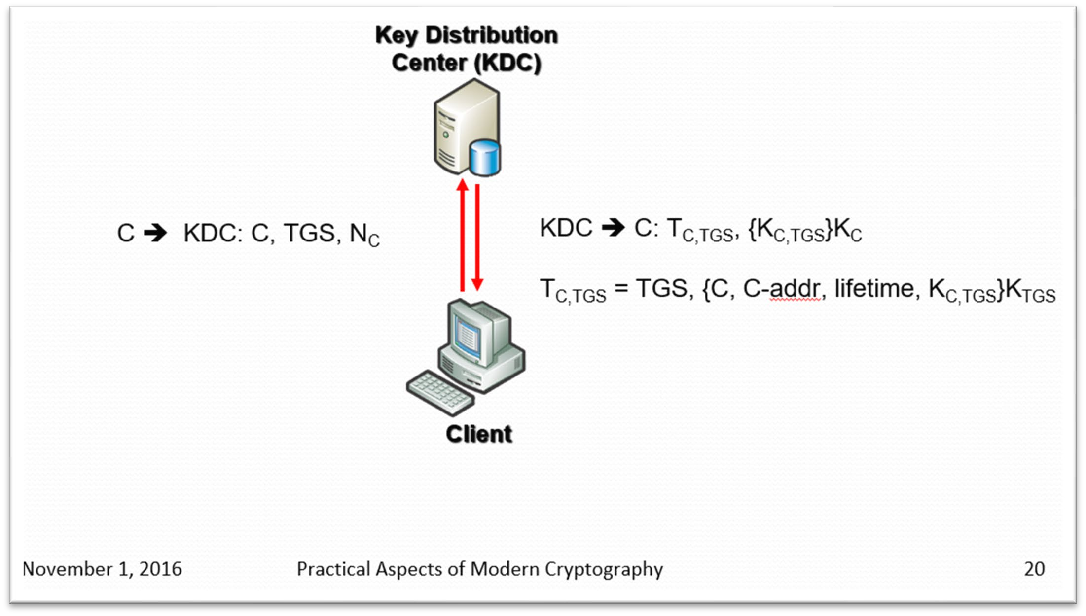
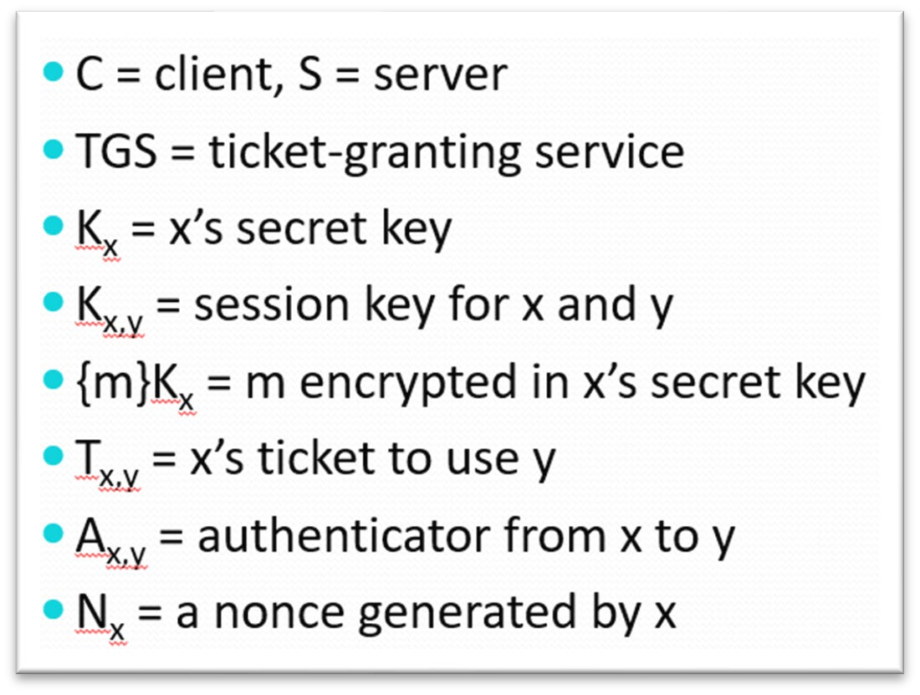
Kerberos
#1: Authentication Service (AS) Exchange – a bit more in depth
https://courses.cs.washington.edu/courses/csep590e/16au/slides/lecture5.pptx, slide 20:
•

Slide 49
#2: Ticket-Granting Service (TGS) Exchange
Used when a principal wants to authenticate to some resource AND they already have a valid TGT (went through the AS exchange previously)
Occurs between a principal and the KDC
If successful, the principal will end up with a TGS Ticket
The TGS ticket will allow the principal to contact the network resource directly and prove its identity to that resource
The TGS exchange uses the concept of an authenticator
This is basically an encrypted timestamp
Principals in a Kerberos realm use an authenticator to prove they have recent access to a particular secret key
An authenticator is verified by decrypting it and verifying the timestamp is recent
(usually less then a few minutes old)

Slide 50
#2: Ticket-Granting Service (TGS) Exchange
Two message types are involved in the TGS exchange:
KRB_TGS_REQ (Principal → KDC)
Principal uses their TGT's session key to encrypt their request to the KDC
Request contains things like realm, the SPN of the service the principal wants to access
An authenticator which proves the sender of this request has access to the session key used to encrypt the request (instead of sniffing someone's traffic and stealing it)
Optional flags/fields
KRB_TGS_REP (Principal ← KDC)
If everything checks out with the request (encryption is OK, authenticator is OK, SPN is valid) the KDC will send the principal another ticket.
Similar to the AS exchange, the ticket will have plaintext and encrypted parts
...but this time the encrypted part is encrypted with the network service's long term secret key

Slide 51
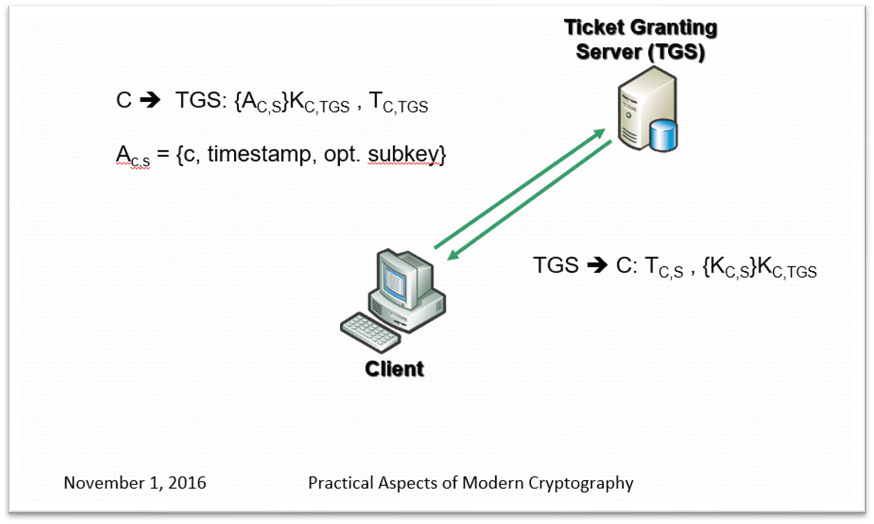
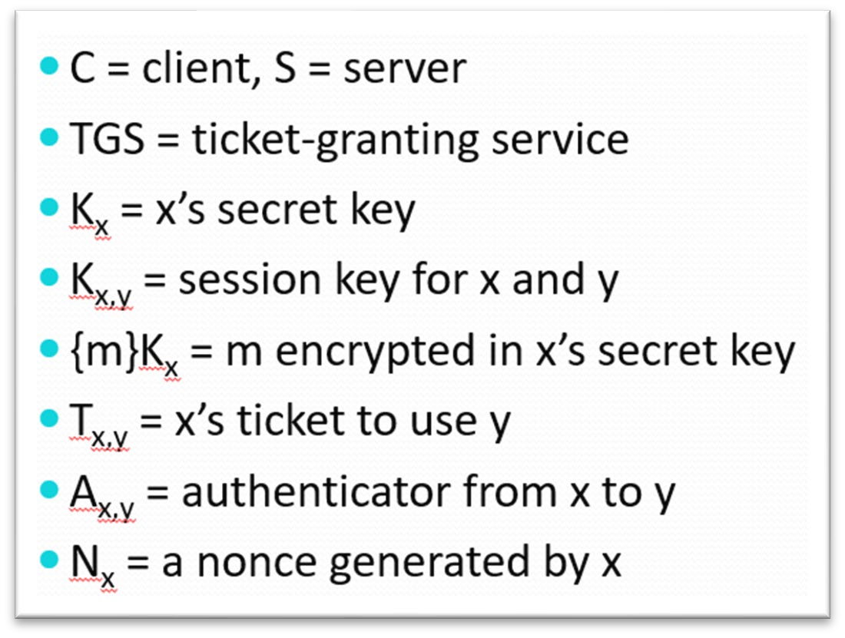
Kerberos
#2: Ticket-Granting Service (TGS) Exchange
https://courses.cs.washington.edu/courses/csep590e/16au/slides/lecture5.pptx, slide 23:

Slide 52
Kerberos
#3: Client-Server Authentication (CS) Exchange
Used to authenticate with a network service assuming principal has a TGS ticket (already went through AS and TGS exchanges)
Occurs between a principal and the network service
If successful, the principal will end up with a valid session with the service
The principal sends the encrypted ticket it got from the TGS exchange to the network service it wants to use
Remember, this encrypted ticket can only be decrypted with the network service's long term secret key
Principal includes another authenticator to prove it has access to the session key the KDC created for the principal and service to talk to each other

Slide 53
Kerberos
#3: Client-Server Authentication (CS) Exchange
Two message types are involved in the TGS exchange:
KRB_AP_REQ (Principal → Network Service)
SPN for the service the principal wants to connect to
Ticket encrypted with Network Service's long term key
Authenticator proving principal has access to the session key
Optional flags; require mutual authentication?
KRB_AP_REP (Principal ← Network Service)
If everything checks out with the request (encryption is OK, authenticator is OK, SPN is valid) the network service may send a reply encrypted with the session key
This reply will contain an authenticator proving Network Service has access to the session key (it was able to decrypt the ticket)
This gives the principal a chance to authenticate the Network Service
This additional step is called “mutual authentication” and it is optional

Slide 54
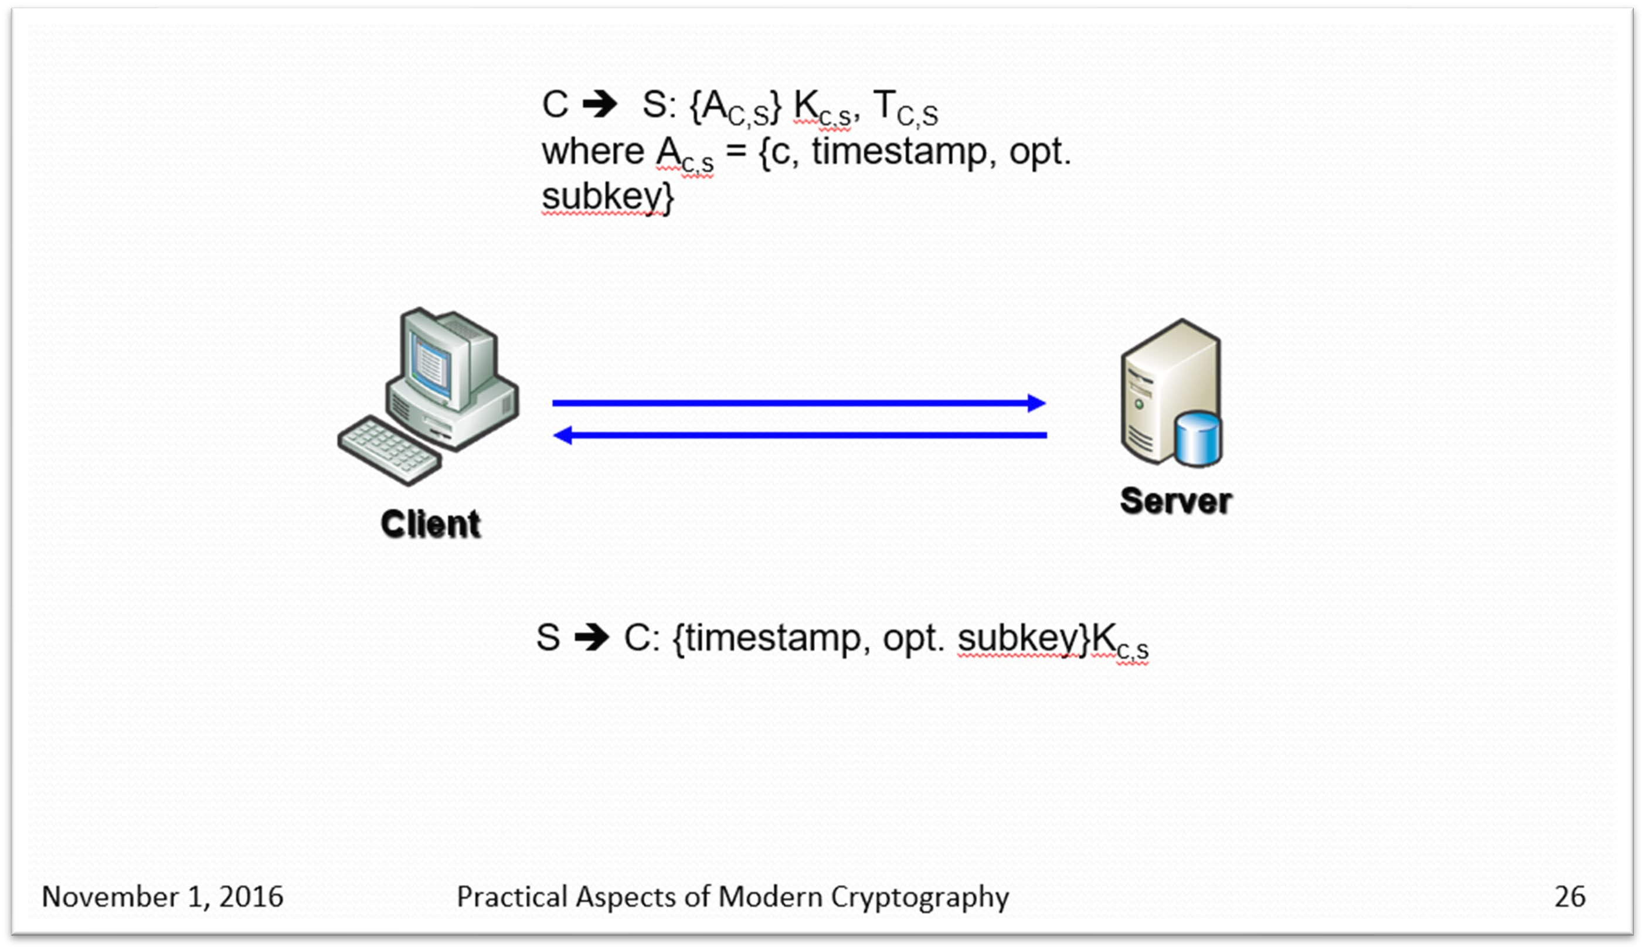
Client-Server Authentication (CS) Exchange again
https://courses.cs.washington.edu/courses/csep590e/16au/slides/lecture5.pptx, slide 26:

